Slide 1
Fruit

Slide 2
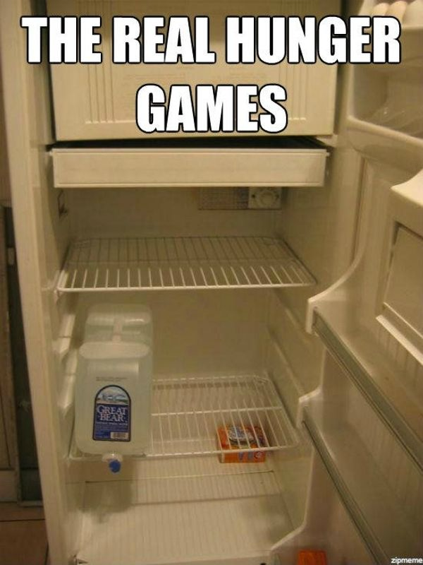

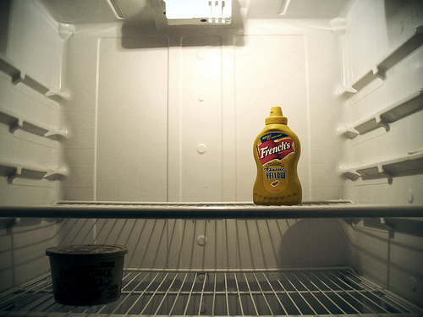

Slide 3
Grapes

Slide 4
Bananas

Slide 5
Orange

Slide 6
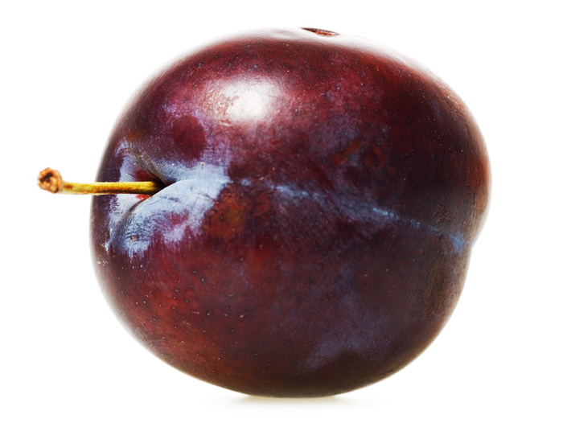
Plum

Slide 7
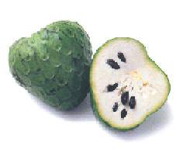
Cherimoya / custard apple

Slide 8
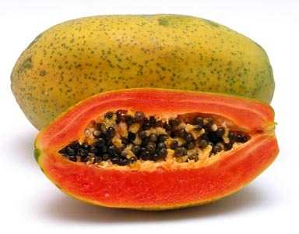
Papaya

Slide 9
Vegetables

Slide 10
Onion

Slide 11
Tomato

Slide 12
Lettuce

Slide 13
Potato

Slide 14
Carrots

Slide 15
Corn

Slide 16
Eggplant

Slide 17
Spring onion

Slide 18
Cauliflower

Slide 19
Artichoke

Slide 20
Drinks

Slide 21

Soda
Juice

Slide 22

Beer
Soft Drink

Slide 23
Dairy

Slide 24


Eggs

Slide 25
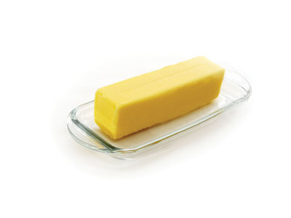
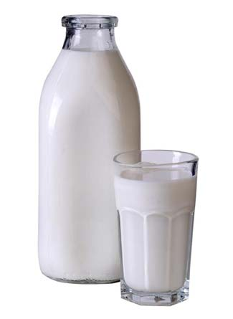

Butter
Milk
Cheese

Slide 26
Meat and poultry

Slide 27
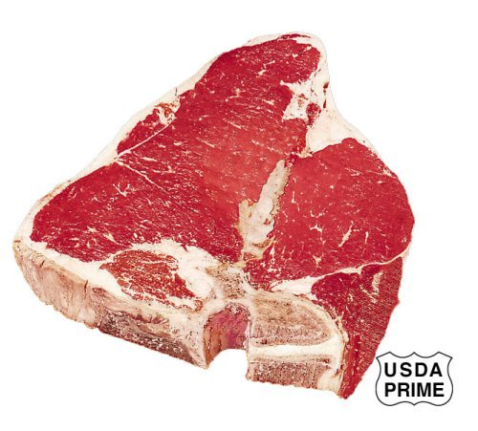
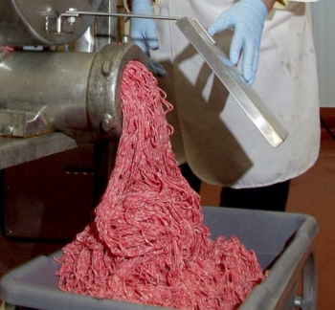
Beef
Ground beef

Slide 28
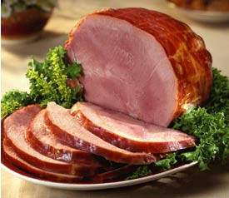

Ham

Slide 29
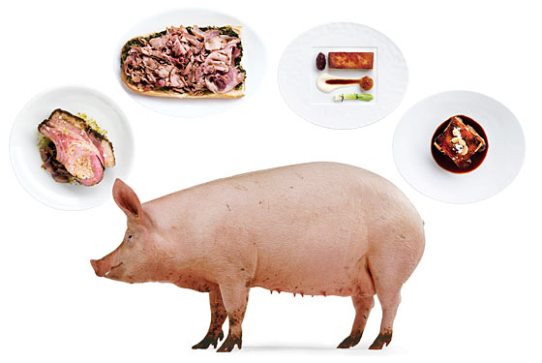
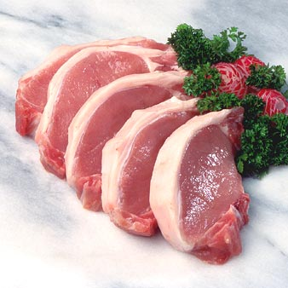
Pork
Pig (Animal)

Slide 30
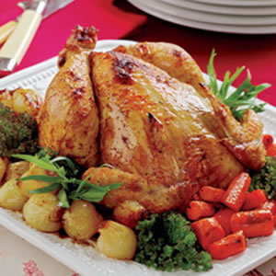
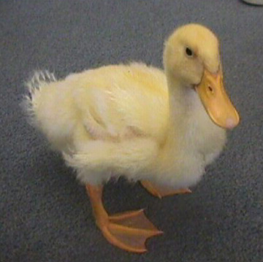
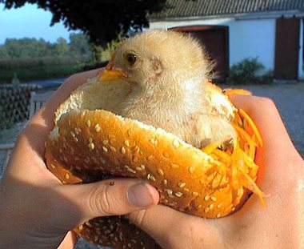
Duck
Chicken

Slide 31
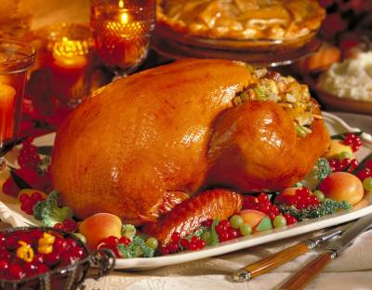
Turkey

Slide 32
Seafood

Slide 33

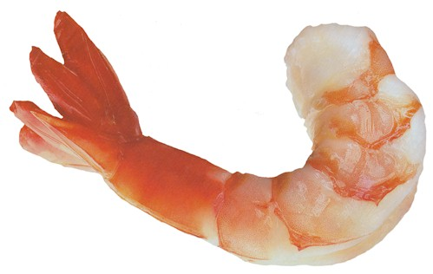
Fish
Shrimp

Slide 34
Pastries and Bread

Slide 35

Cake

Slide 36
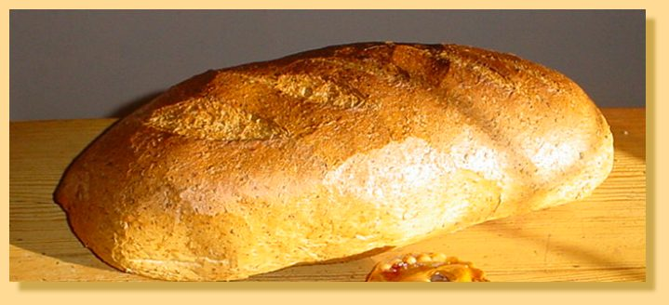
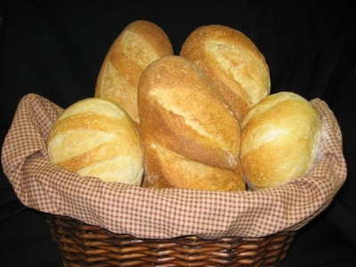
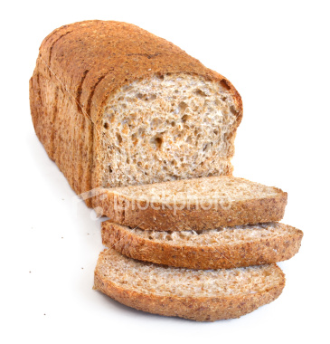
A Loaf of Bread
Bread rolls

